Slide 1

PhD Supervisors Meeting
xx/xx/24

Slide 2

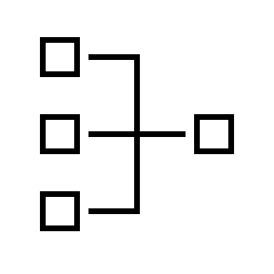
Agenda
Exploring Challenge in FL
Developing Research Area

Slide 3
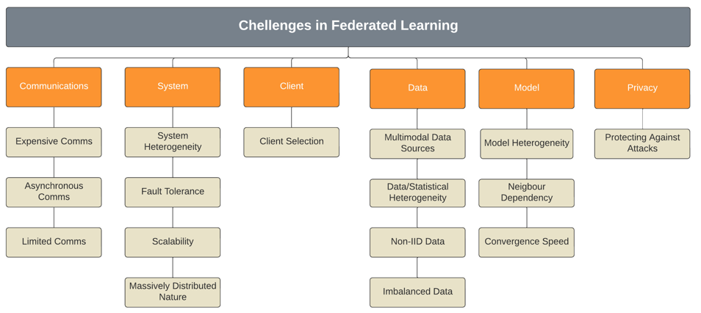
Exploring Challenges in FL
Communication: The link between the server and clients, or between devices
System: The network, when taken as a whole (i.e., sever, clients, etc.)
Client: The remote device or entity which does the local training
Data: The data gathered by the client, which is used for local training
Model: The ML model which is run on the various system elements
Privacy: The need to keep data safe and secure

Slide 4
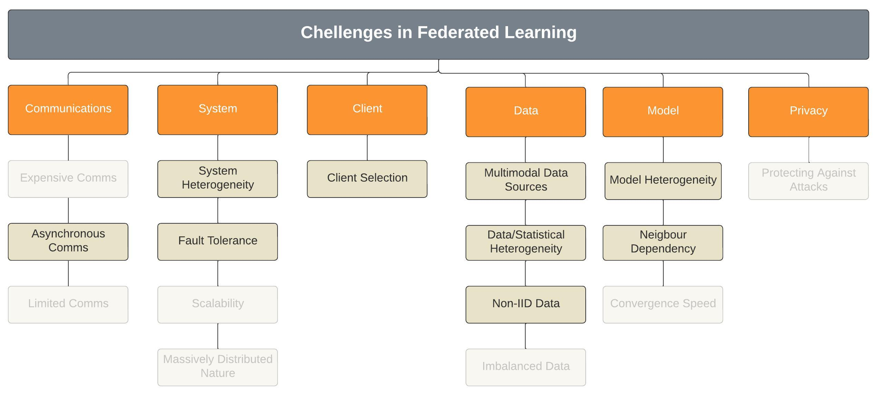
Exploring Challenges in FL – Removing Topics
Communication: The link between the server and clients, or between devices
System: The network, when taken as a whole (i.e., sever, clients, etc.)
Client: The remote device or entity which does the local training
Data: The data gathered by the client, which is used for local training
Model: The ML model which is run on the various system elements
Privacy: The need to keep data safe and secure

Slide 5
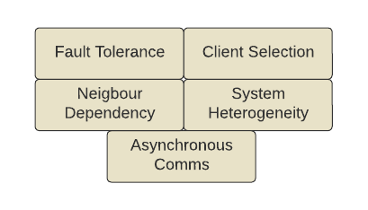
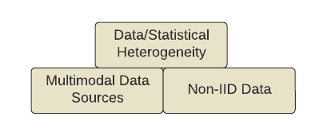
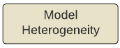
Grouping
The challenges identified seem like they could be related, and as such can be grouped together

Slide 6
Areas of Interest
From my reading so far, the main areas of interest are:
Multimodal data sources, and with non-IID data
Can a model be adaptable to the input data
Select clients for a given need
Asynchronous communications
Included in this is the development on an adaptive communications strategy
Efficient data communications
Adapt to changing network conditions
Fault tolerance
This there a way to try and predict faults – more important for smaller networks, less so for very large ones

